Slide 1


Online attendance system for students admitted in the university courses.

Slide 2
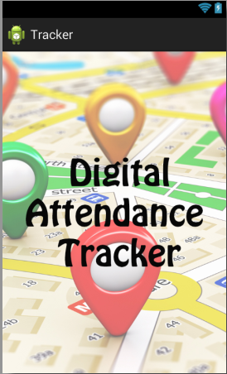

FEATURES
GEO - TAGGING
THREE LEVEL REPORTING
SECURE
..LOCKING ATTENDENCE
OFFLINE ATTENDANCE STORAGE

Slide 3
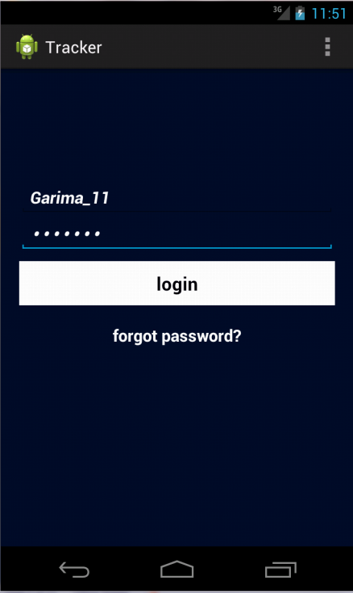


STUDENT LOGIN PROCESS
To mark attendance you need to first register for this app to get your unique user name password .

Slide 4
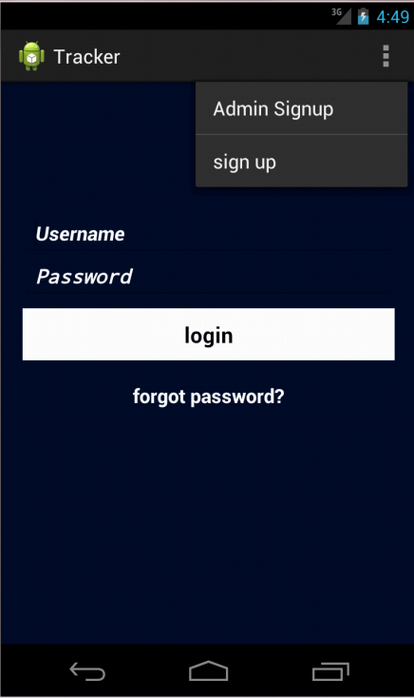

SIGN UP PROCESS
First Sign up to register for this app

Slide 5
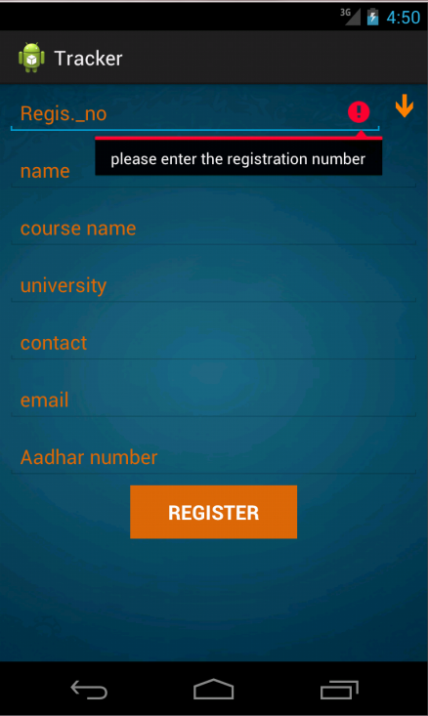

STUDENT VERIFICATION PROCESS
Enter your university registration number to register.

Slide 6
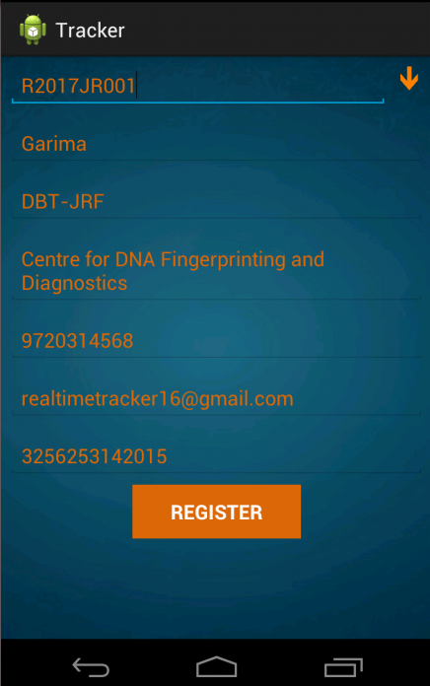

STUDENT VERIFICATION PROCESS
Fetch button , fetch your details on a click from university server through your REG_NUM
Will send OTP on your email –id for verification purpose.

Slide 7
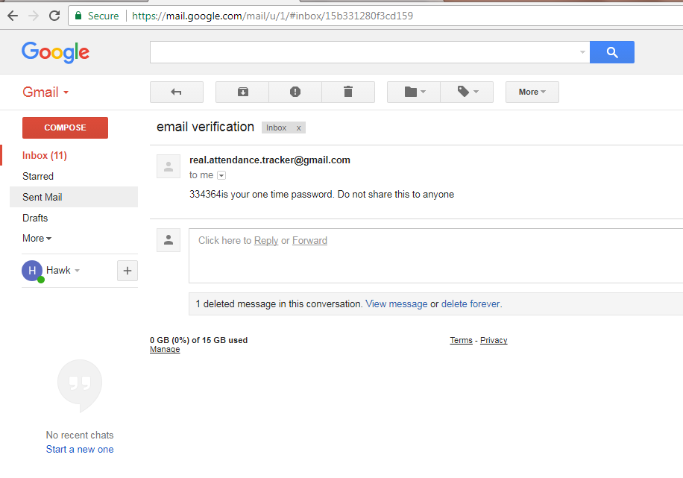
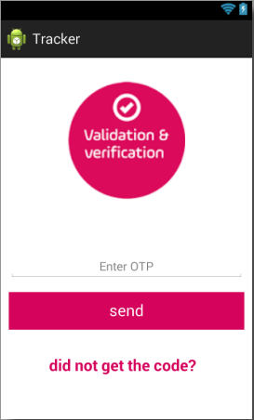

VERIFICATION Contd.
Input OTP and complete the your verification process.

Slide 8
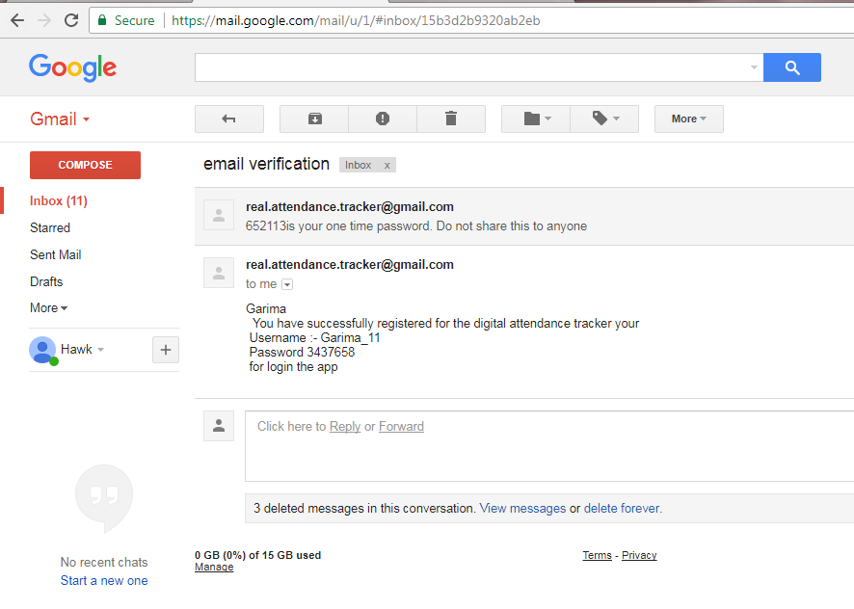




SUCCESSFUL VERIFICATION.
Continue to login process now.

Slide 9
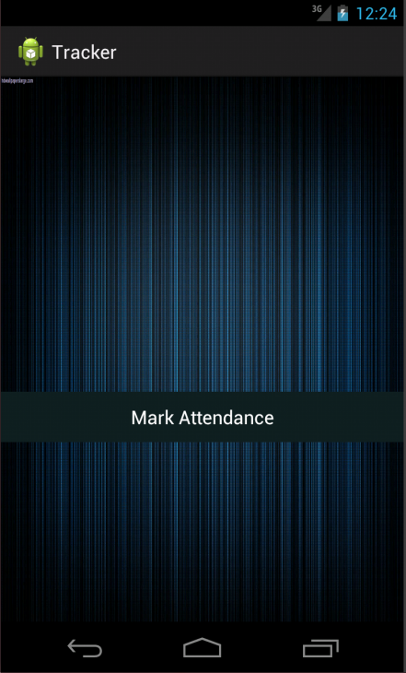
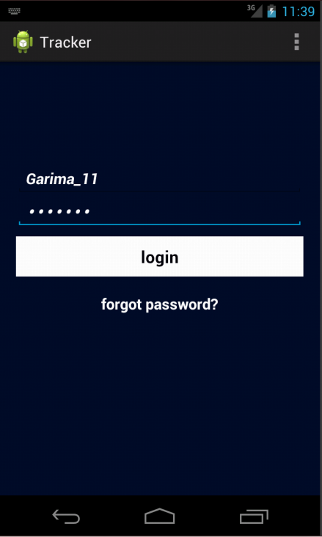

LOGIN WITH CORRECT CREDENTIALS

Slide 10





MARK ATTENDANCE
LON-LAT values of a student will be stored in a database.

Slide 11
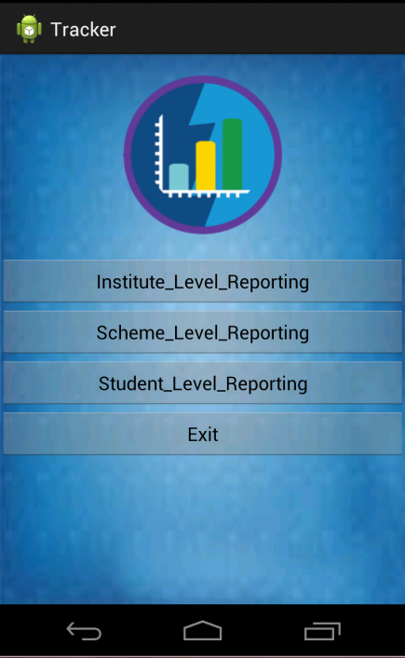

THREE LEVEL REPORTING.

